Slide 1
Expense tracker
By:
Sinthu kumarasamy
Namratha vatti
Vinitha koppula
Supriya gadesula

Slide 2
Technologies used:
Front end Framework: React js
Front end technologies: Html,css , javascript
Back end technologies: Nodejs, Express

Slide 3
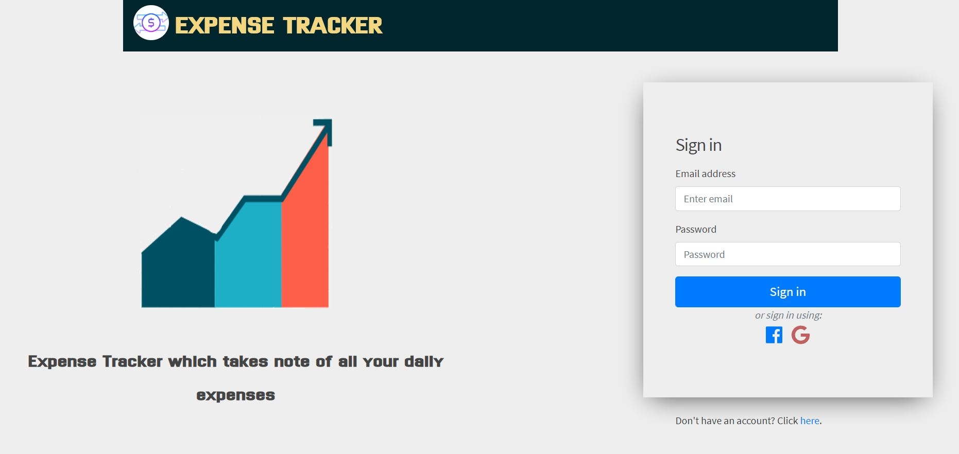
Login page

Slide 4
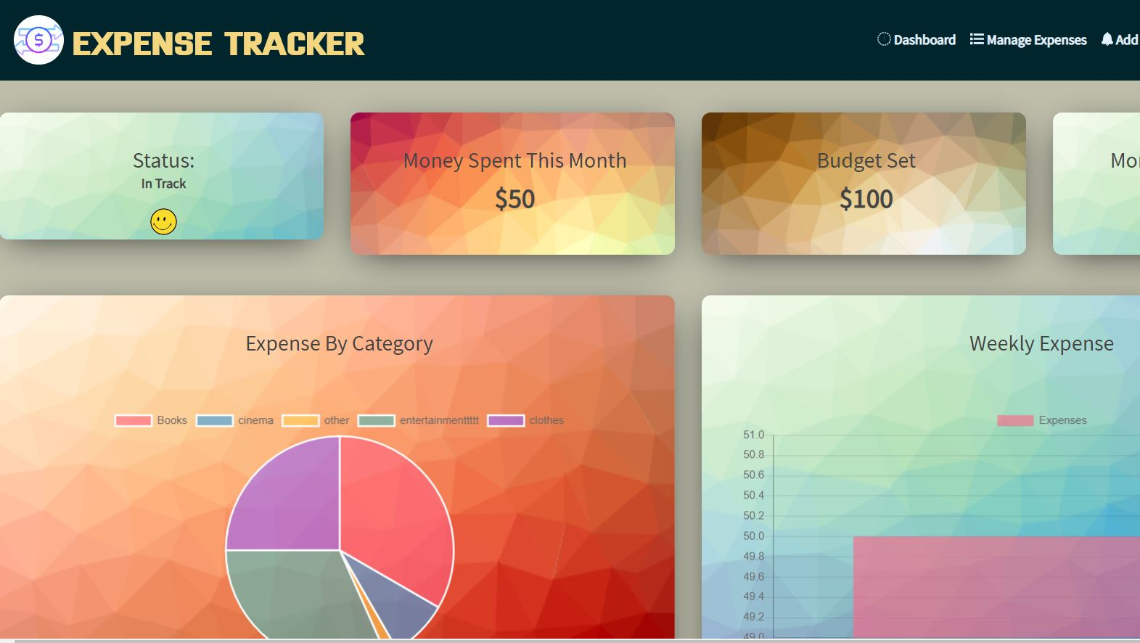
Dashboard page

